Slide 1
Chronic Total Coronary Occlusion (CTO)- PCI Strategies
Dr. Suneesh K

Slide 2
Introduction
CTO are present in about 20-50% of patients with relevant CAD
More than 50% have well-preserved LV function
More than 80% have no Q-waves in CTO territory
Only 8-15% are undergone PCI
Major predictor of advising against PCI, in favor of GDMT/CABG
Notes:
This practise pattern likely reflects uncertainty regarding the clinical benefits of CTO PCI
as well as high technical challenges with this procedure.
Fortunately…………

Slide 3
Introduction
Thanks to specific wires and sophisticated techniques continuously evolving since the early 1990s…
…. owing to a few strenuously enthusiastic CTO PCI advocates like O Katoh, H Tamai and T Suzuki
Shift in long-term patency from < 50% to >90% due to DES
Notes:
And of course

Slide 4
Introduction
Every interventionist dreams of expertise in CTO PCI
…but its a last niche in the field of interventional cardiology!
Review CTO PCI here in 2016 era with the available evidence and devices and methods to recanalize it

Slide 5
Outline
Definition- Prevalence
Indications
Pre-procedure planning
Guidewires and microcatheters
Wire crossing strategies
Complications

Slide 6
Definition
Degree of lumen narrowing
Antegrade blood flow
Age of occlusion
Define CTO

Slide 7
CTO: Definition
Euro CTO club definition
Presence of TIMI 0 flow within an occluded arterial segment of ≥99% stenosis, >3 months duration**
**Sianos G, Werner GS, Galassi AR, et al. Recanalisation of chronic totalcoronary occlusions:
2012 consensus document from the EuroCTO club. EuroIntervention. 2012;8(1):139-45
Notes:
The arbitrary duration of 3 months is used

Slide 8
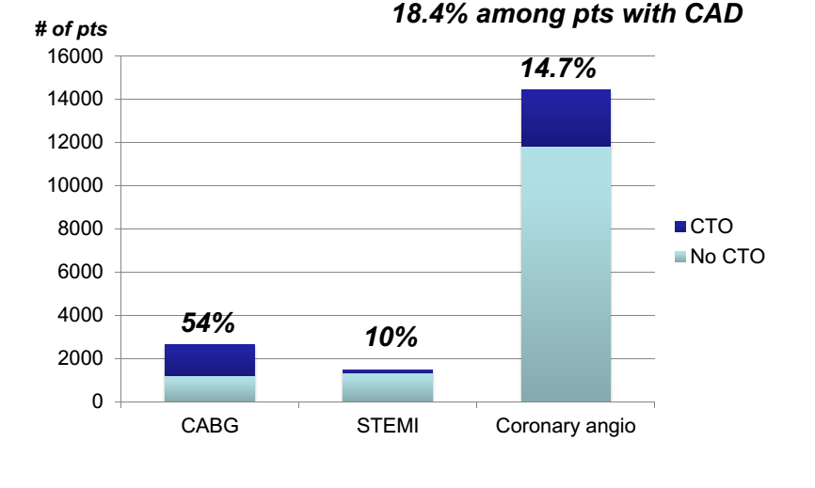
Prevalence Canadian Multi-center CTO Registry
April 2008-July 2009
n= 14439
10% non culprit CTOs in Primary PCI for STEMI
87% ≥ CCS Class 2
36% CTO→ PCI
Fefer P, Knudtson ML, Cheema AN, et al. Current perspectives on coronary chronic total occlusions:
the Canadian Multicenter Chronic Total Occlusions Registry. J Am Coll Cardiol. 2012;59(11):991-7
Notes:
Then, Why are they important?
One of the reasons they are important because they are very common
Large Canadian prospective registry
3 Canadian academic institutions
Patients with previous CABG and STEMI were excluded from the study

Slide 9
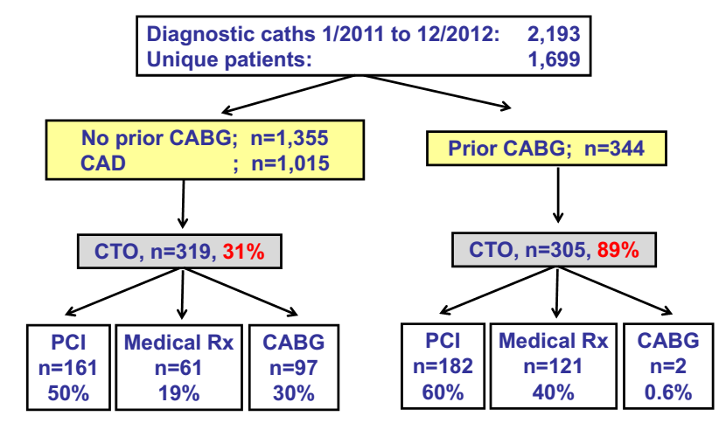
Prevalence of CTOs and choice of revascularization in Dallas VAMC
Jeroudi O et al. CCI 2013

Slide 10
Prevalence
BARI Trial- CTO- In 30% of all CAG in patients with CAD**
Claessen, et al- Worse prognosis of patients with a CTO in a non-infarct related artery (Based on HORIZON AMI Trial)*
* Claessen BE, Dangas GD, Weisz G, et al. Prognostic impact of a chronic total occlusion in a non-infarct-related artery in patients with ST segment elevation myocardial infarction: 3-year results from the HORIZONS-AMI trial. Eur Heart J. 2012;33(6):768-75
** Bourassa MG, Roubin GS, Detre KM, et al. Bypass angioplastyrevascularization investigation: patient screening, selection, and recruitment. Am J Cardiol. 1995;75(9):3C-8C
Notes:
Claessen, et al. retrospectively evaluated 3283 STEMI patients undergoing primary
PCI within the HORIZONS-AMI trial and confirmed the worse prognosis of patients
with a CTO in a non-infarct related artery

Slide 11
Pathology of CTO Lesion
Heavy atherosclerotic plaque burden
A tough, fibrous cap at the proximal and distal margins
Softer material in between
Hard plaques are more prevalent with increasing CTO age
Aziz S, Ramsdale DR. Chronic total occlusions--a stiff challenge requiring
a major breakthrough: is there light at the end of the tunnel? Heart.2005;91(Suppl 3):iii42-8.

Slide 12
Pathology of CTO Lesion
Well-developed collaterals may provide a flow equivalent to a 90% stenosis → Maintain myocardial viability
But FFR of collaterals to CTO is <0.8
Age-related changes in intimal plaque → Fibrocalcific
Neovascular microchannels within CTO - Basis of 2 approaches
Notes:
Autopsy studies demonstrated
some extending from the proximal to the distal lumen
but others, leading to small side branches or vasa vasorum in the vessel wall
Antegrade and retrograde guide wires

Slide 13
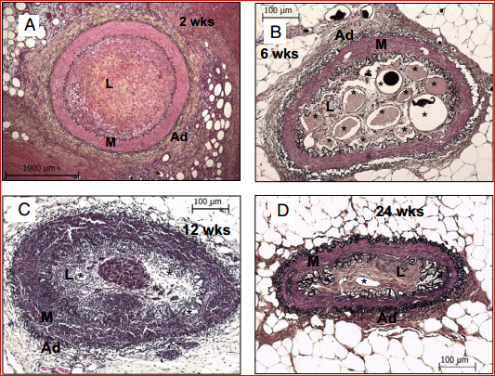
Pathology of CTO Lesion
Proximal and distal fibrous caps act as barriers forcing the guidewire
Density of distal fibrous cap is lesser than that of the proximal cap
Overall contractile function may be normal, or a RWMA may be present
Notes:
Movat-Stained Sections Showing Temporal Changes in Vessel Size and Intraluminal Microvessels
Representative histological sections of occlusions at 2(A),6(B),12(C), and 24 weeks (D)
There was marked reduction in vessel size at 6 weeks (note the differences in calibration)
Microvessels (indicated by*) were maximal at 6 weeks with a decrease at the later time period

Slide 14
Presentation
Stable angina, a change in angina status, silent ischemia or heart failure of ischemic origin
> 50% have well-preserved LV fn
> 80% have no Q-waves in the CTO territory
Ge JB. Current status of percutaneous coronary intervention of chronic total occlusion. J Zhejiang Univ Sci B. 2012;13(8):589-602

Slide 15
Why CTO Intervention Necessary?

Slide 16
Why open a CTO?
↓ Angina TOAST-GISE study, FACTOR trial
↑ LV function
↓Consequences of future ACS
↓Arrhythmias
↓CABG
↓Nitrate use…?! Viagra
Patient
Interventionist
Help patient
Improve PCI skills
Notes:
For some of our patients Viagra is very important for quality of life,
So by doing CTO interventions, many pt s can stop nitrate, can have Viagra and happy relax
At the same time the cardiologist, who feel good because

Slide 17
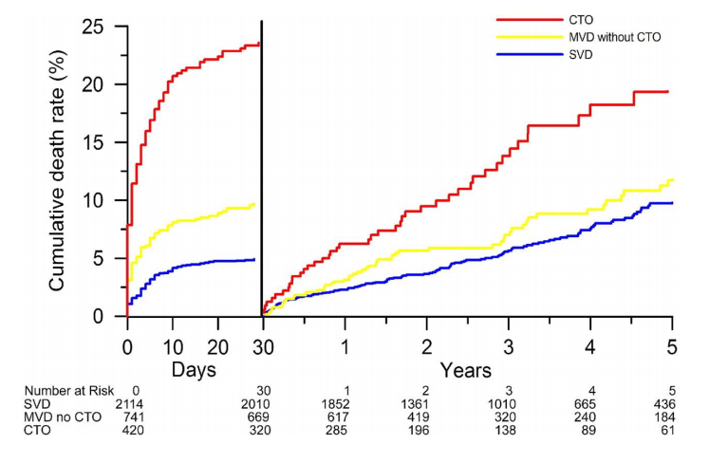
Impact of CTO on outcomes post STEMI
Claessen, B. E.P.M. et al. J Am Coll Cardiol Intv 2009;2:1128-1134
Notes:
1 in 4 dies
But if u have no CTO mortality is much much less

Slide 18
Garcia, Brilakis et al. J Am Coll Cardiol. 2013;62:1421-1431
Notes:
Number 1 reason for incomplete revascularizn is CTO

Slide 19
Let us review the literature..
Observational studies
Retrospective studies
No RCT
.
Notes:
Upon successful reopening, angina will improve, functional tests will be normalized, LV will improve and CABG will be avoided
(Based on observational studies)
Successful PCI → reduce mortality & requirement for CABG (Based on retrospective studies)
Several studies reported the adverse impact of incomplete revascularization on subsequent clinical outcome

Slide 20
SYNTAX trial
2005-2007
Complete revascularization- in only 53% of PCI
CTO- Strongest independent predictor of incomplete revascularization after PCI (HR 2.70; 95% CI-1.98-3.67; P<0.001)
CTO PCI success was only 49%
30 % CTOs referred for CABG were not surgically revascularized
Most grafts to CTO arteries other than LAD occluded after 1 year
Notes:
Limited experience in CTO PCI of many participating centers and the limited availability of CTO crossing techniques

Slide 21
Observational Studies Demonstrating Significant Reductions in Mortality With Successful PCI for CTO
No | First Author | n | Time period | Follow-Up | Procedural Success rate | Survival With Successful vs. Failed CTO PCI, p Value
1 | Prasad et al. | 1262 | 1979-2005 | Cumulative 10-yr | 67% | 72% vs. 77%, p = 0.025
2 | Suero et al. | 2007 | 1980-1999 | Cumulative 10-yr | 70% | 73.5% vs. 65%, p = 0.001
3 | Noguchi et al. | 226 | 1986-1996 | Cumulative 12-yr | 59% | 95% vs. 84%, p < 0.05
4 | Hoye et al. | 874 | 1992-2002 | Cumulative 5-yr | 65% | 93.5% vs. 88%, p = 0.02
5 | Olivari et al. | 369 | 1999-2000 | 1 year | 73% | 99.7% vs. 96.4%, p = 0.037
6 | Aziz et al. | 543 | 2000-2004 | Cumulative 2-yr | 69% | 98.0% vs. 94.2%, p = 0.049
7 | Valenti et al. | 486 | 2003-2006 | Cumulative 4-yr | 71% | 91.6% vs. 87.4%, p = 0.025

Slide 22
Mehran et al.
Multicenter observational study
Long-term clinical outcomes of 1,791 patients after PCI for CTO
Successful CTO PCI - independent predictor of ↓ cardiac mortality with a strong trend toward lower all-cause mortality
Mehran R, Claessen BE, Godino C, et al. Long-term outcome of percutaneous coronary intervention for chronic total occlusions. JACC Cardiovasc Interv. 2011;4(9):952-61.

Slide 23
CTO-PCI long term outcome: Seuro et al
Follow-up of largest reported series of patients undergoing CTO PCI
20-Year observational study
Compared procedural outcomes and long-term survival for CTO PCI
Between June 1980 and December1999
2,007 CTO PCI and 2,007 non-CTO PCI
Suero J a, Marso SP, Jones PG, et al. Procedural outcomes and longterm survival among patients undergoing percutaneous coronary intervention of a chronic total occlusion in native coronary arteries: a 20-year experience.
J Am Coll Cardiol. 2001;38(2):409-14
Notes:
patients undergoing PCI of a CTO with a matched non-CTO cohort to determine whether successful PCI of a CTO is associated with improved survival

Slide 24
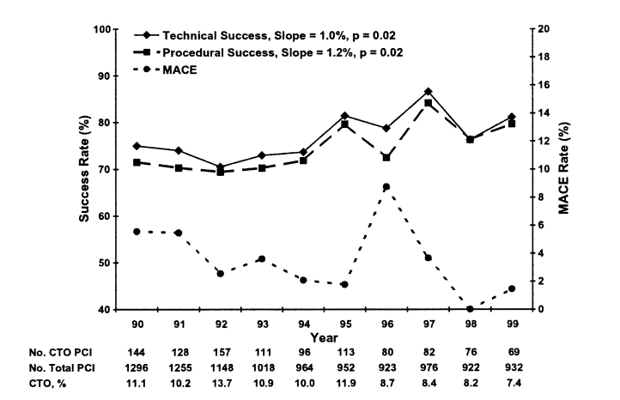
Seuro et al: Results
In-hospital MACE rate
3.8% in CTO cohort
Suero J a, J Am Coll Cardiol. 2001;38(2):409-14

Slide 25
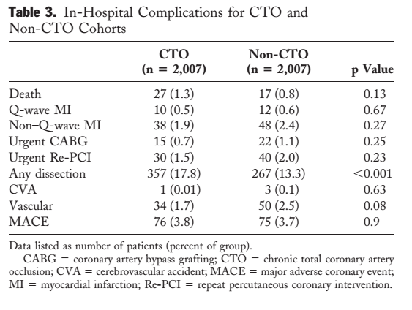
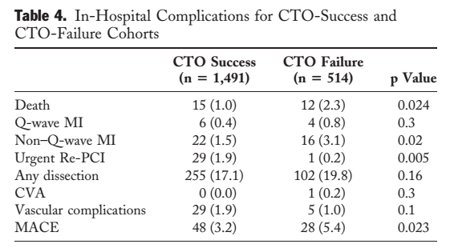
Seuro et al: Results
Suero J a, J Am Coll Cardiol. 2001;38(2):409-14

Slide 26
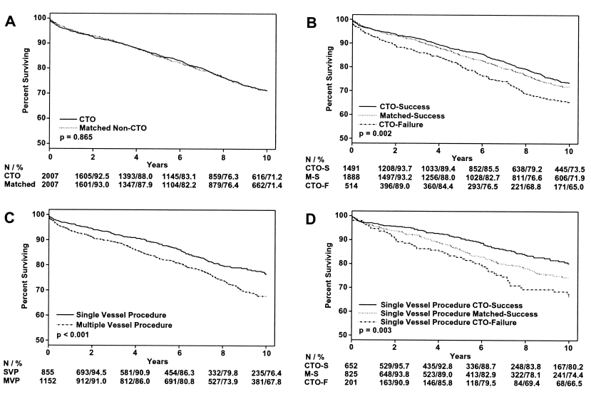
71.2% vs. 71.4%
p = 0.9
73.5% vs. 65.1% p = 0.001)
76.4% vs. 67.8% p= 0.001
80.2% vs. 66.5% p= 0.008
Suero J a, J Am Coll Cardiol. 2001;38(2):409-14

Slide 27
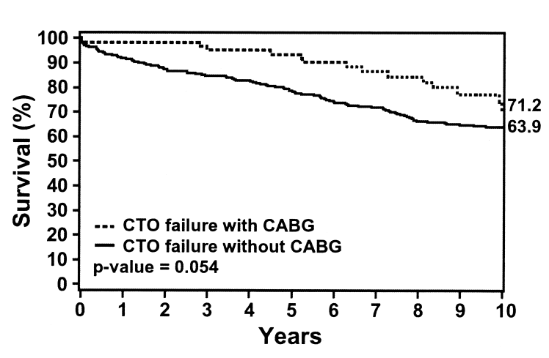
Seuro et al: Results
514 CTO failures
64 CABG within 30 days
10-year survival
71.2% CABG group
63.9% no CABG group (p=0.04)
Stent 10%
No Thienopyridine
Stent 35%
Thienopyridine
Suero J a, J Am Coll Cardiol. 2001;38(2):409-14
Notes:
Thus, with the low percentage of patients receiving a stent, these
findings cannot be completely extended to current practice
patterns.

Slide 28
Jones et al: CTO long-term survival
Single centre
6,996 patients underwent elective PCI for stable angina
2003 to 2010
836 (11.9%) for CTO
All-cause mortality was obtained to 5 years
Stratified according to successful CTO(sCTO) or unsuccessful CTO (uCTO)
Jones DA, Weerackody R, Rathod K, et al. Successful recanalization of chronic total occlusions is associated with improved long-term survival.JCIN. 2012;5(4):380-8
Notes:
Impact of procedural success on mortality following CTO PCI in DES era

Slide 29
Jones et al: CTO long-term survival
69.6% procedures were successful
Stents were implanted in 97.0% of successful procedures
Mean: 2.3 ± 0.1 stents per patient, 73% DES
Prior revascularization - frequent among uCTO patients: CABG(16.5% vs. 7.4%; p < 0.0001), PCI (36.0% vs. 21.2%; p < 0.0001)
Intraprocedural complications, including coronary dissection, were more frequent in unsuccessful cases (20.5% vs. 4.9%; p < 0.0001), but did not affect in-hospital MACE (3% vs. 2.1%; p = NS)
Jones DA, Weerackody R, Rathod K, et al. Successful recanalization of chronic total occlusions is associated with improved long-term survival.JCIN. 2012;5(4):380-8

Slide 30
Jones et al: CTO long-term survival
All-cause mortality -17.2% for uCTO and 4.5% for sCTO at 5 yrs follow-up (p < 0.0001)
Need for CABG was reduced following sCTO (3.1% vs. 22.1%; p < 0.0001)
Multivariate analysis demonstrated that procedural success was independently predictive of mortality (HR: 0.32 [95% CI: 0.18 to 0.58])
Jones DA, Weerackody R, Rathod K, et al. Successful recanalization of chronic total occlusions is associated with improved long-term survival.JCIN. 2012;5(4):380-8
Notes:
Successful CTO PCI is associated with improved survival out to 5 years

Slide 31
CTO-PCI outcome variability by Target Vessel
Compared survival benefit of opening a CTO of LAD, LCX, or RCA
Eligible patients underwent attempted CTO PCI in a single vessel
Procedural success rates were calculated for each vessel
Primary end point - Survival at 5 years, compared across target vessel groups stratified by procedural success
Safley DM, House JA, Marso SP, et al. Improvement in survival following successful percutaneous coronary intervention of coronary chronic total occlusions: variability by target vessel. JACC Cardiovasc Interv. 2008;1(3):295-302.

Slide 32
CTO-PCI outcome variability by Target Vessel
2,608 patients included
LAD was the target vessel in 36%, LCX in 26%, and RCA 38%
Angiographic success rates for LAD were 77%, LCX 76%, and RCA 72%
CTO PCI success in LAD group – a/w decreased mortality risk (HR: 0.61, 95% CI: 0.42 to 0.89)
Safley DM, House JA, Marso SP, et al. Improvement in survival following successful percutaneous coronary intervention of coronary chronic total occlusions: variability by target vessel. JACC Cardiovasc Interv. 2008;1(3):295-302.
Notes:
In multivariable analysis, CTO

Slide 33
Meta-analysis of the effect of PCI on CTO
16 Observational studies
n= 6,695 CTO success group
n= 2,370 CTO failure group
Low CTO success- A/w old age, previous CABG, multivessel CAD and RCA
MACE, recurrent ACS, all-cause death, angina incidence, subsequent CABG and cumulative survival rate were found significantly reduced with CTO success
Li R, Yang S, Tang L, et al. Meta-analysis of the effect of percutaneous coronary intervention on chronic total coronary occlusions. J
Cardiothorac Surg. 2014;9:41
Notes:
16 articles

Slide 34
RCTs are in horizon
DECISION-CTO Trial
Drug-Eluting Stent Implantation Versus OMT in Patients With CTO
EURO-CTO Trial
European Study on the Utilization of Revascularization versus OMT for the Treatment of CTO
Notes:
The lack of randomized-controlled trials comparing CTO PCI with optimal medical therapy led to initiation of two large randomized-controlled clinical trials
DECISION CTO is assessing whether, compared to optimal medical therapy, CTO PCI will reduce the composite endpoint of all-cause death, myocardial infarction (MI), stroke, and any revascularization at 3 years after randomization.
Biosensors biolimus-eluting stent plus optimal medical therapy

Slide 35
Success Rates of CTO intervention
Jones DA, Weerackody R, Rathod K, et al. Successful recanalization of chronic total occlusions is associated with
improved long-term survival. JCIN. 2012;5(4):380-8
Notes:
Success rates of 80–90% are consistently achieved in experienced hands with a safety profile comparable to standard risk-adjusted PCI

Slide 36
The most common failure mode of CTO interventions remains the inability to successfully cross the occlusion with a guidewire
Retrograde approach through collateral channels has been introduced to cross complex CTOs
Older occlusions, greater CTO length, a non-tapered stump, the origin of a side branch of the occlusion site, and calcification negatively affect the ability to successfully cross a CT

Slide 37
J-CTO Score
This study sought to establish a model for grading lesion difficulty in interventional CTO treatment
494 native CTO lesions were analysed
Successful guidewire crossing within 30 min was set as an end point
Morino Y, Abe M, Morimoto T, et al. Predicting successful guidewire crossing through chronic total occlusion of native coronary lesions within 30 minutes: the J-CTO (Multicenter CTO Registry in Japan) score as a difficulty grading and time assessment tool. JACC Cardiovasc Interv. 2011;4(2):213-21.

Slide 38
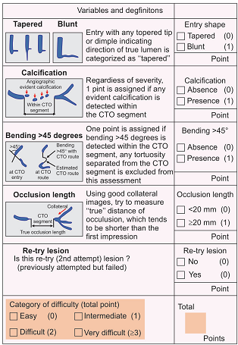
J-CTO Score
Multicenter CTO Registry of Japan score
5 Parameters
1 point for each
Source: Cardiovascular Interventions. JACC. 2011;4(2).

Slide 39
J-CTO Score
The set end point was achieved in 48.2% of lesions
Independent predictors included calcification, bending, blunt stump, occlusion length >20 mm, and previously failed lesion
CTO Score | Success in <30 min (%)
0 | 92.3
1 | 58.3
2 | 34.8
≤ 3 | 22.2
Source: Cardiovascular Interventions. JACC. 2011;4(2).

Slide 40
Challenges of CTO lesions PCI
Inability to see the course of the vessel at the site of occlusion
Difficulty in crossing longer CTO lesion with a coronary guidewire
Delivery of coronary balloons and stents into these fibrocalcific lesions can be difficult
Significant use of catheterization laboratory resources, with procedure times and fluoroscopic times
Shah PB. Management of coronary chronic total occlusion. Circulation. 2011;123(16):1780-4
Notes:
Because of the heavy atherosclerotic plaque burden,

Slide 41
Challenges of CTO lesions PCI
Requirement of multiple hard wares
Potential for radiation dermal injury and contrast induced AKI
Significant risk for vessel dissection
Collateral disruption and ischemia
Shah PB. Management of coronary chronic total occlusion. Circulation. 2011;123(16):1780-4

Slide 42
What we do is, “Hybrid” now
Notes:
Which essentially try to incorporate all the available technique available to cross the lesion

Slide 43
“Hybrid”
an offspring resulting
from cross-breeding
“Liger” Crossbreed for lion and tiger- Bigger than either !
Notes:
And this is an eg of what a hybrid is
If you cross breed a lion and tiger, you will get something called a liger, which is bigger , powerful and better than either.
Similary hybrid technique is better than any individual techniuue
Put 2 catheters to both legs and take pictures of both coronaries at a same time

Slide 44
Pre-procedure planning
In-depth clinical assessment
20 min of pre-procedure review of the angiogram
Understanding the vessel course and the presence, quality, and location of collateral vessels
CTO day- Avoid “ad hoc” CTO PCI

Slide 45
Dual injection
Selective CAG from CTO PCI target vessel and through another vessel (the contralateral coronary artery or a bypass graft)
Crucial for determining
Lesion length
Size and location of segment of artery distal to CTO
For evaluating whether there is a significant bifurcation at the distal cap
Can reveal presence, size, and tortuosity of collaterals
For deciding on the optimal CTO PCI strategy

Slide 46
Dual injection
Low magnification
Inject donor vessel first
Wait 1-2 Sec before injecting CTO vessel
No panning
Cine until contrast clears

Slide 47
Dual injection
2 guide catheter strategy
Dual arterial access commonly used (bi-femoral, bi-radial, femoral-radial)
Long (35 to 45 cm) sheaths and large-bore guide catheters (7- 8 F)

Slide 48
Hybrid CTO crossing algorithm
1
Dual Injection
2
Ambiguous proximal cap
Poor distal target
Appropriate interventional collaterals
No
Yes
Antegrade
6
Retrograde
3
Lesion length < 20mm
Yes
No
Antegrade
dissection and
reentry
Retrograde
true lumen
puncture
Retrograde
Dissection and
reentry
4
Antegrade
wiring
5
Controlled
(Stingray)
Wire based
(LaST)
7
Switch strategy
Brilakis et al JACC Intv2012
Notes:
The first step to achieving success with PCI for CTO is to perform
appropriate CAG and to properly interpret the angiograms before
starting the procedure.

Slide 49
Studying the CTO: Focus on 4 Elements
By whom ? Entire Cath team
How long ? 15-20 min
How ?
Proximal cap ambiguity
Lesion length
Quality of distal vessel
Collaterals
Notes:
Frame by fram study of the CAG to know how the anatomy looks like
FOCUS ON 4 ELEMENTS

Slide 50
Strategic plan
Goal is to develop a clear strategic plan
Based on anatomy
Which approach ?
Which vessel/ collateral to engage 1st?
Notes:
For successful intervention

Slide 51
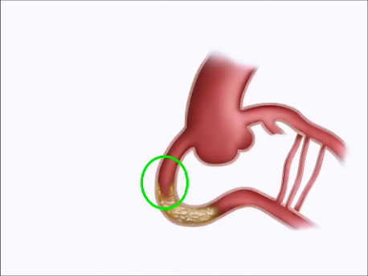
Proximal cap
Proximal vessel
tortuosity- caliber
Ambiguous or clear?
Tapered or blunt?
Side branch?
Calcification
Notes:
What we will look in the proximal cap?
1st we will look how the vessel proximal to the lesion
Next we will look how the proximal cap is? Is it clear or ambiguous

Slide 52
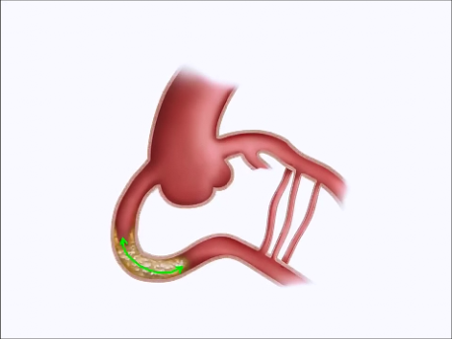
Lesion length
Notes:
DUAL INJ IS V IMP BECAUSE SINGLE INJECTION INVARIABLY OVER ESTIMATE…

Slide 53
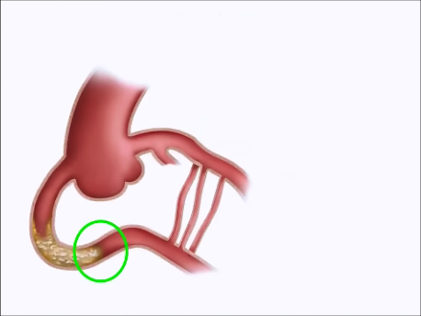
Distal cap
Caliber and quality of
Distal vessel
Bifurcations
Prior bypass graft
Insertion sites

Slide 54
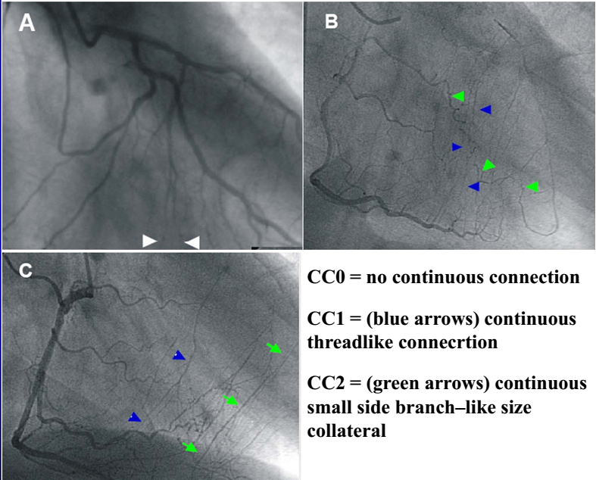
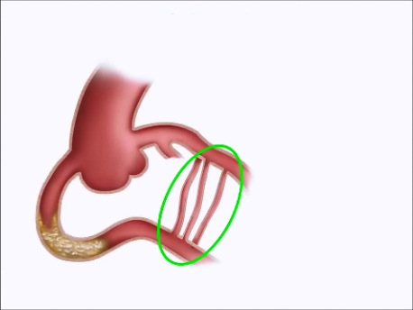
Collaterals
Type- Septal,
bypass graft, epicardial
Size-
Werner Classification
Tortuosity
Dominance
Angle and location of entry

Slide 55
CTO PCI: Basics
Approach- Femoral 45 cm sheath
Guide- 7 or 8 French
Virtually always- Dual injections
Anticoagulation- Heparin
Monitor radiation
Ready to manage complications- Perforation, tamponade

Slide 56
Guide wires for CTO
Failure to cross the occlusion is the main reason (85%) for an unsuccessful PCI in CTOs
Proper guidewire selection guided by lesion morphology and improved techniques of guidewire manipulation are the keys to successfully cross the lesion

Slide 57
CTO Guide wires
Polymer coated FIELDER
WHISPER
PILOT FAMILY
Non-polymer coated spring coil tipped
CHOICE PT
PT GRAPHIX
CROSSWIRE NT

Slide 58
CTO Guide wires
Plastic jacket guidewires
Polymer coating that covers the whole length of the guidewire
Additional hydrophilic coating for maximum lubricity
So all polymer guidewires are hydrophilic
Due to the extreme lubricity these wires lack tactile sensation
To provide for tactile feedback, spring coils at the tip can be incorporated beneath the polymer coating
Extreme low friction - improves crossability and tip flexibility
Wires of choice for tortuous lesions and lesions having microchannel
Ideal for antegrade STAR technique and for retrograde CTO recanalization
Highly prone to repeatedly seek false channels
Increased propensity to cause wire tip perforations
Impractical in calcific or densely fibrotic lesions
Not ideal for blunt occlusions without an advancing nipple and occlusions having a patent side branch originating at the level of CTO
Polymer coated
Non-polymer coated spring coil tipped

Slide 59
Non-polymer coated spring coil tipped
Bare stainless steel guidewires without any polymer coating
For improving manipulation by reducing friction, coated with hydrophobic (wax-like, silicone) or hydrophilic (gel-like, hydrocoat) material
Hydrophobic coating - better tactile feedback and tip control
Ideal for calcific and densely fibrotic lesions, blunt occlusions without advancing nipple, occlusions with side branch origin at level of CTO
Preferred wires in parallel wire technique as the second wire

Slide 60
Non-polymer coated spring coil wires
Hydrphilic
CROSS-IT
PERSUADER
Hydrophobic
MIRACLE BROS
CONFIANZA
SHINOBI
Hybrid wire
CONQUEST/
CONFIANZA-
PRO

Slide 61
Non-polymer coated spring coil wires
Flat tip
MIRACLEBROS
SHINOBI
PERSUADER 3g
PERSUADER 6g
Tapered tip
CONFIANZA-
PRO
CROSS-IT
PERSUADER 9g

Slide 62
4 important features regarding CTO wires
Polymer covers
Wire coatings
Core materials and tapering
Tip stiffness
Tip stiffness: This range from 0.5 g to 20 g. Tip tapering strongly affects penetration power as the force is applied over a smaller cross-sectional area in tapered wires
Polymer covers: Plastic sleeves of flexible but solid material that are applied directly over the core or over spring coils covering the tip of the wire
Wire coatings: 2 types, Hydrophilic and Hydrophobic. These coatings cover the working area of wire, excluding tip
Core materials and tapering: Majority of CTO wires has a stainless steel core. Modern CTO wires have a transitionless parabolic core grind which provides excellent torque response

Slide 63
Major requirements for guidewire
Push transmission | Advancement
Torque transmission | Allow turning the tip
Body support | Allows placement of a balloon
Tip support | Allows moving the tip to search for the true lumen
Elasticity | Shape memory retention
Flexibility | Vascular trauma
Visibility | Radiopaque marker
Tactile feedback | Hydrophobic > hydrophilic

Slide 64
Notes:
There is no single guidewire that can be universally used in all
CTO lesions and in all possible circumstances.
Familiarity with various CTO guidewires, proper selection based on angiographic features
and utilizing proper wiring techniques is necessary for
success in CTO PCI

Slide 65
Role of microcatheters in CTO PCI
Microcatheters and over-the-wire (OTW) balloons are low profile and trackable systems with end-holes
Important requisite tools for successful CTO PCI
Provide support to the coronary guidewire and allow precise guidewire control by preventing flexion, kinking and prolapse of the guidewire

Slide 66
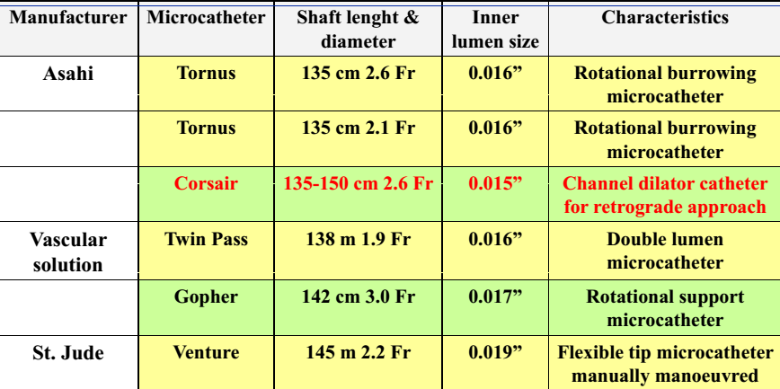
Role of microcatheters in CTO PCI
OTW systems allow for rapid exchange of coronary guidewires
Also allow distal coronary injections to be made to define anatomy
Added advantage of dilating CTO segment once it has been crossed
Notes:
Both of these functions are extremely
important for success of the procedure

Slide 67
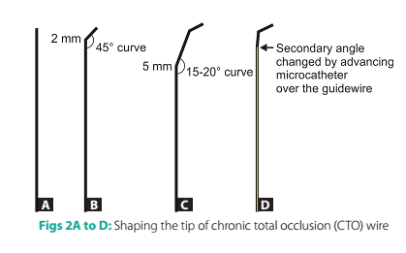
Tip shaping
Initial and most basic step
Rule-of-thumb for tip shaping
Primary and secondary curves
OTW microcatheters adjust 2nd curve
Notes:
Shaping the tip of guidewire is the initial and most
basic step of guidewire manipulation
The universally accepted
rule of thumb for tip shaping of guidewires in nonoccluded
vessels is to keep the radius of tip angle equal to the size of artery
in which the wire is to be negotiated
In CTOs, the size of artery is practically zero; hence, the distal tip radius has to be very small, A secondary curve of
15−20°, 3−5 mm proximal to the distal curve may additionally be
made to orient the tip of the guidewire in the expected direction
of the stump. This secondary curve can be adjusted by moving to
and fro the OTW microcatheter over the guidewire

Slide 68
Different wiring techniques
Basic wiring technique
Advance antegrade wiring technique
Retrograde wiring technique
Drilling
Penetrating
Sliding
Notes:
Determined by the morphology of lesion on angiography
Choice of coronary guidewire is determined by the technique chosen

Slide 69
Drilling approach
CTO with distinct advancing nipple at the entry point
Moderately stiff (tip-load) guidewires having high torque control
Gradual Step up
Slow controlled advancement
Ineffective with blunt heavily calcific lesion
MiracleBros 3 g/4.5 g/6 g
Persuader 3 g/6 g
Cross-IT XT 100/200/300
Indian Heart J. 2009; 61:275-280
Notes:
The pushing force of wire can be changed
by gradually increasing the tip load from 3 g to 12 g (step-up
technique).

Slide 70
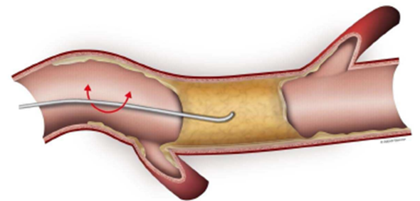
Drilling approach
Wire handling is crucial
Mandates controlled drilling with alternating clockwise and counter-clockwise rotations of less than 90° along with very slow advancement
Uncontrolled drilling should not be done
Notes:
Uncontrolled drilling should not be done as it can deflect the
wire leading to subintimal entry, dissections and perforations

Slide 71
Drilling approach

Slide 72
Penetrating approach
Suitable for longstanding CTOs having hard and fibrocalcific lesions
Stiff wires with small and tapering tip
Very small forward pushing movements along the direction of lumen across the CTO
Directional control of wire movement should be finer than drilling
Not for tortuous lesion & bridging collaterals: Perforation risk
High stiffness of these wires increases the risk of subintimal dissection and perforations

Slide 73
Conquest Pro 9 g/12 g
Cross-IT XT 400
MiracleBros 12

Slide 74
Sliding approach
CTO of relatively shorter duration < 6 months
Suspected/ visible microchannel
Low friction polymer coated guidewire
Fielder
Crosswire NT
HT Pilot
Whisper
Choice PT

Slide 75
Sliding approach

Slide 76
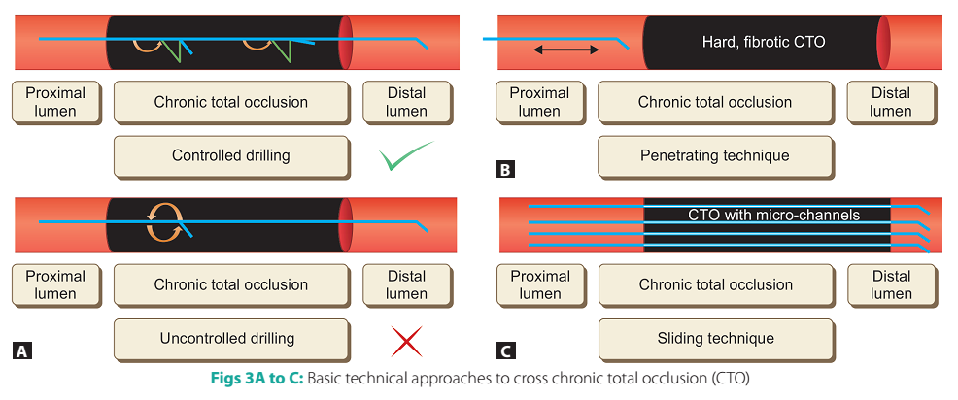

Slide 77
Advance Antegrade Wiring Techniques
Parallel wire technique
Antegrade subintimal dissection and re-entry techniques
Antegrade intentional intimal plaque tracking technique
Notes:
Many a times a CTO is not easily crossed by the basic techniques
described above

Slide 78
Parallel wire technique
When the guidewire has entered subintimal space
Dont push further
2nd wire of increasing stiffness parallel to 1st
1st wire acts as a guide & prevent 2nd wire from entering the false lumen
2nd wire- never take polymer coated wire
Avoid repeated antegrade contrast
SEE SAW technique – Both wires supported by microcatheters or an OTW balloon
Adopt the technique before a large subintimal dissection
Employ multiple orthogonal angiographic views
Notes:
Careful manipulation of the second wire,
slightly deviating from the course of the initial wire can lead
to successful entry to the true lumen.
Both the wires may be supported by a microcatheter or an OTW balloon, in that
case the technique is termed as “see-saw technique”

Slide 79
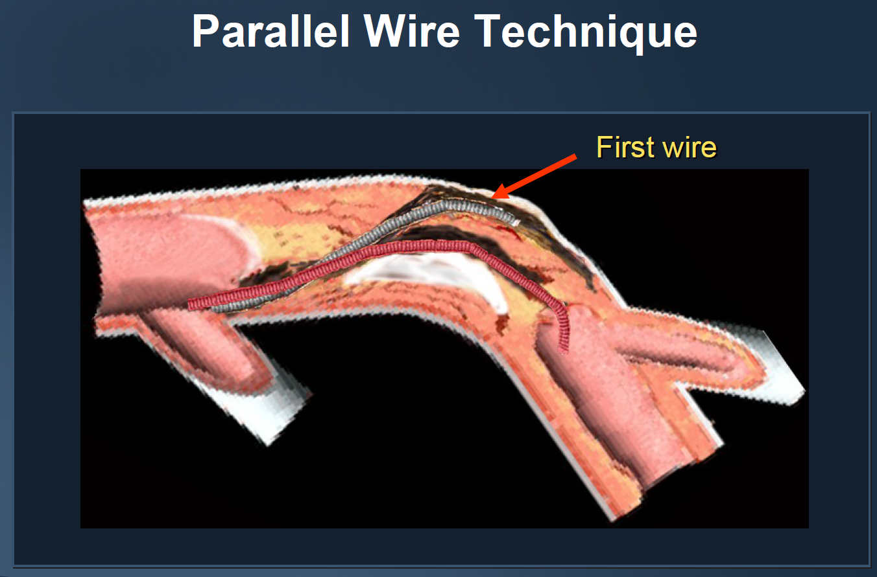

Slide 80
Antegrade Subintimal Dissection and Re-entry Techniques
Involve two steps
(1) Creation of subintimal dissection of varying length spanning the length of CTO
(2) Re-entry into the true lumen using various re-entry techniques
Notes:
initially described for crossing peripheral arterial CTOs
Development of specialized equipment and advanced coronary hardware

Slide 81
Subintimal Tracking And Re-entry technique
Continuous advancement of the knuckled polymer-coated guidewire till it spontaneously enters the true lumen
Spontaneous re-entry occurs after considerable subintimal course
Re-entry is usually at distal bifurcation
Associated with side branch compromise
Not recommended in vessels with major side branches

Slide 82
“Knuckle wire technique”
Antegrade dissection- By pushing a polymer-coated (plastic jacketed) guidewire, so as to form a tight loop at its tip
This wire is then advanced into the subintimal space

Slide 83
Contrast-guided STAR technique
To simplify STAR
Puncture the proximal fibrotic cap with a stiff wire
Advance a microcatheter or an OTW balloon into the lesion
Inject 1-2 mL contrast into the lesion after removing the guidewire
Subintimal dissection is visualized
Tubular dissections and storm cloud dissection
Notes:
Tubular dissections appear as linear contrast
opacification along the length of vessel wall and are
ideal for STAR technique. Under the guidance of contrast
injections a polymer jacketed knuckle wire is inserted in the
tubular subintimal dissection and advanced until it enters
the distal true lumen, thus successfully accomplishing
the STAR procedure. Storm cloud dissections observed as
diffuse staining of contrast media are not suited for STAR
technique and call for abandoning the procedure.

Slide 84
Mini-STAR technique and Limited Antegrade Subintimal Tracking (LAST)
Modifications of the STAR technique
Devised to prevent SB compromise
Enter the true lumen as proximally as possible
Mini-STAR- Polymercoated wire (Fielder FC/XT), tip is shaped to 2 curves
LAST- Stiffer guidewires with a/c distal bend (Confianza Pro12/Pilot 200)
Notes:
Unlike conventional STAR technique in which the wire tip is allowed to make
a loop producing a knuckle, in mini-STAR technique the
wire tip is shaped to incorporate two curves, a primary(40º–50º) at the distal end (1–2 mm proximal to the tip)
and a secondary curve (15º–20º) 3−5 mm proximal to the tip.

Slide 85
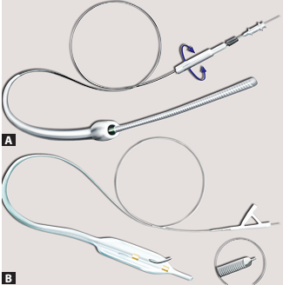
Dedicated devices for guided subintimal re-entry
Bridge-Point Medical System
CrossBoss CTO crossing catheter
Stingray CTO re-entry system

Slide 86
CrossBoss CTO crossing catheter
Metal OTW microcatheter with rounded tip to prevent vessel exit
Device rotated rapidly in either direction using fast spin
Can advance through the CTO without a wire in the lead
Subintimal position- true lumen reentry performed
Smaller subadventitial space – less likely to accumulate blood
Hydrophilic coated, multi-wire coiled shaft provides precise turn-for-turn response
Fast-Spin torque device allows rapid rotation of the catheter to facilitate crossing
bostonscientific.com

Slide 87
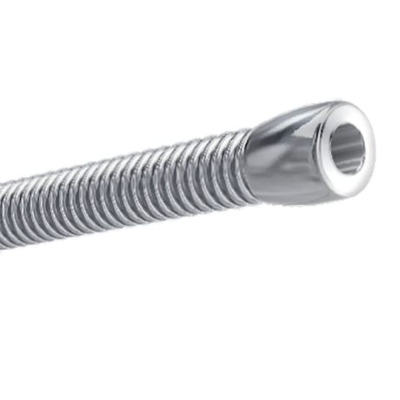
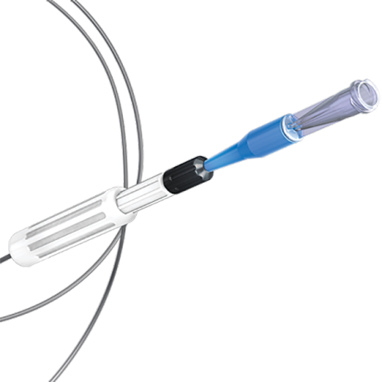
CrossBoss CTO crossing catheter
1.0 mm atraumatic distal tip
Multi-wire coiled shaft
Fast-Spin torque device
bostonscientific.com

Slide 88
Stingray Coronary CTO Re-Entry System
1mm flat balloon with 3 exit ports connected to the same lumen
Distal exit port – for balloon positioning
Other 2 180º opposed to each other
Uses guidewire with extreme tapered tip (0.0025) for rentry
Distal true lumen entry confirmed by contralateral injection
Self-orienting, flat balloon hugs the vessel, automatically positioning one exit port toward the true lumen
bostonscientific.com

Slide 89
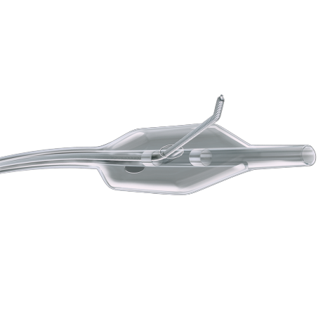
Stingray Coronary CTO Re-Entry System
Angled guidewire with distal probes
180˚ opposed and offsetting exit ports
bostonscientific.com

Slide 90
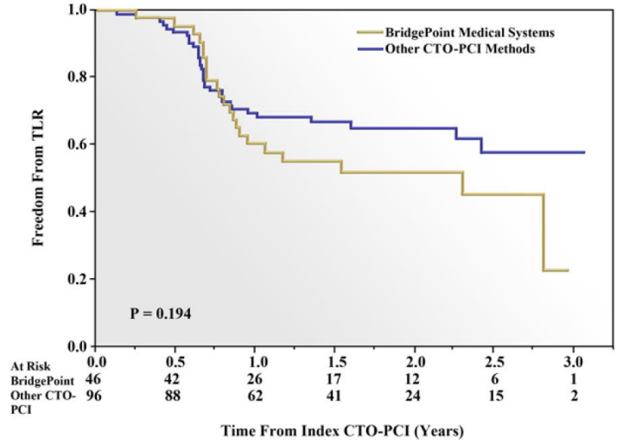
FAST-CTOs trial
Higher technical success
(77% versus 59%, p < 0.001)
Shorter fluoro time (p <0.001)
Whitlow PL, Burke MN, Lombardi WL, et al. Use of a novel crossing and reentry system in coronary chronic total occlusions that have failed standard crossing techniques: results of the FAST-CTOs (Facilitated Antegrade Steering Technique in Chronic Total Occlusions) trial. JACC Cardiovasc Interv. 2012;5(4):393-401

Slide 91
Antegrade intimal plaque tracking
Intentionally directing the guidewire into the intimal plaque
Intentional loose tissue tracking or intentional intimal plaque tracking
Higher success rate of CTO recanalization as compared to subintimal tracking
Notes:
The intimal tissue, even though tougher, provides a homogenous
milieu for wire advancement leading to the tendency of
the wire tip to stay directed towards the true lumen, and
eventually higher success of recanalization.

Slide 92
Retrograde Wiring Techniques

Slide 93
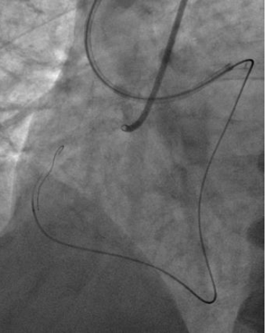
Retrograde Wiring Techniques
Initially used after a failed antegrade approach
Distal cap of CTO is often softer and less fibrotic
Not considered as first-line approach and is reserved for prior failed attempts of antegrade approach
Notes:
Retrograde approach, pioneered by Japanese operators, utilizes the concept of
accessing the distal segment of an occluded artery through these
collateral channels and attempting to cross the CTO retrogradely
from distal to proximal segment.
Advances in guidewire technology with availability of polymer-coated soft-tipped wires and microcatheters have led to
wider acceptability of this approach for CTO PCI. However, still
retrograde approach is not considered as first-line approach and
is reserved for prior failed attempts of antegrade approach

Slide 94
Retrograde Approach (Contd..)
Now used as initial strategy in challenging cases
Ostial occlusion
Long occlusion
Without stump
Large side branch
Severe tortuosity
Visible continuous collaterals

Slide 95
Standardized Procedures of Retrograde Approach
7 Fr guiding catheter with a side hole from LFA/LRA
Super-selective dye injection from a microcatheter- Collaterals
Septal collaterals are preferred- Because they are dilatable
Soft polymeric wire with a microcatheter (Corsair) is employed

Slide 96
Standardized Procedures of Retrograde Approach
Slippery wires used for collaterals
Epicardial- Runthrough (Terumo), Whisper (Abbott), Sion (Asahi)
Septal- Fielder FC (Asahi), Fielder XT (Asahi)
Cork screw- Fielder XT, Fielder XT-R (Asahi)
After the successful delivery of a slippery wire, the microcatheter is advanced towards the distal coronary artery via collaterals
If the microcatheter (preferably Corsair) cannot be advanced, septal dilatation may be performed with a 1.0-1.25 mm OTW balloon to 2-3 atm

Slide 97
Retrograde Approach (Contd..)
3 possible routes to reach distal cap of a CTO
Through arterial or venous grafts anastomosed to the distal Vessel
Through epicardial collaterals
Through septal collateral channels
Septal collaterals are the preferred collaterals owing to their shorter, less tortuous route and feasibility of balloon dilation for facilitating device passage without significant risk of perforation and tamponade

Slide 98
Septal collateral crossing technique
Septal surfing
Advance guidewire through collateral without contrast visualization
Contrast guided
Wire advancement after selective (through Corsair tip) or nonselective(through guide catheter)- Contrast injection identify best crossing route
Notes:
Surfing greek-US/ fast
Contrast guided- Japan/ time consuming

Slide 99
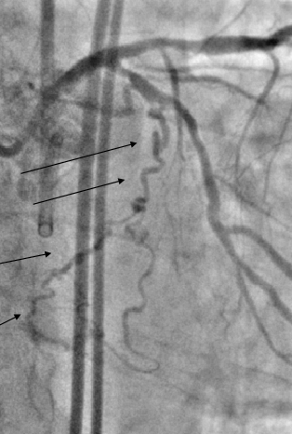
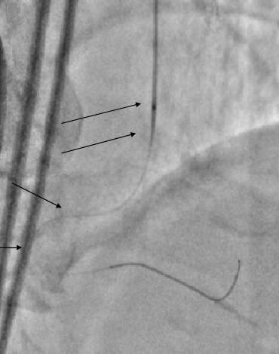
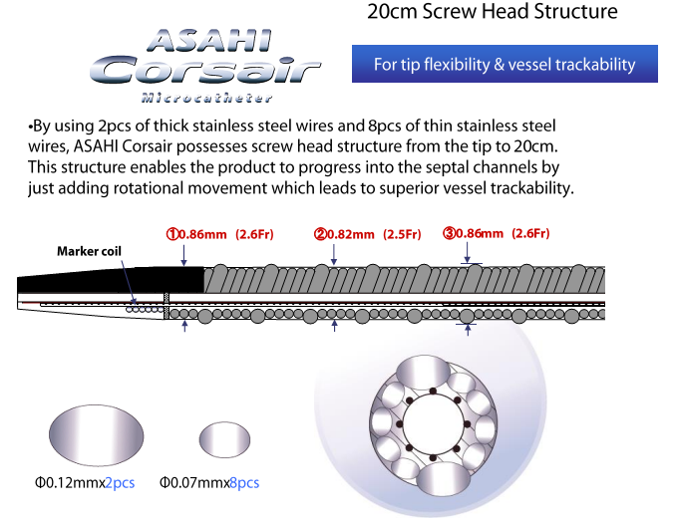
Retrograde Approach (Contd..)
Hydrophilic soft-tipped floppy guidewires are ideal for negotiating these collateral channels
Use of microcatheter is mandatory
Terumo Fine-Cross
Super-Cross
Turnpike
Corsair microcatheter
Corsair- Extra ordinary trackability
Notes:
Use of microcatheter is mandatory to provide support to these floppy guidewires and
allow precise guidewire control by preventing flexion, kinking
and prolapse.

Slide 100
Wiring Strategies for Retrograde Approach
Retrograde wire cross
Kissing wire cross
Controlled antegrade and retrograde tracking (CART)
Reverse CART

Slide 101
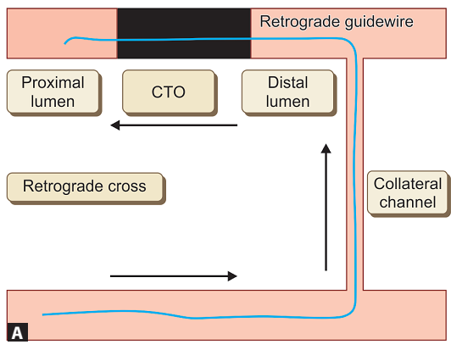
Retrograde wire cross
Notes:
Initially a soft tapered wire (Fielder
XT®, Runthrough NS® tapered) is tried, if unsuccessful then
dedicated recanalization wires like Miracle series with gradual
increase in tip stiffness can be tried.

Slide 102
Kissing wire cross
Marker wire technique
Simultaneous combined use of the antegrade and retrograde approaches
Retrograde guidewire in the distal vessel serves as a marker of the distal CTO location and aids in maneuvering of the antegrade guidewire until both meet (kiss) each other
Can avoid additional contrast need for anterograde wire
Notes:
renal dysfunction in whom contrast dose is limited
However
currently this technique has fallen out of favor against the now
preferred CART technique (described below), and is used only
when CART cannot be performed due to failure of bringing an
OTW balloon catheter through the intercoronary channel.

Slide 103
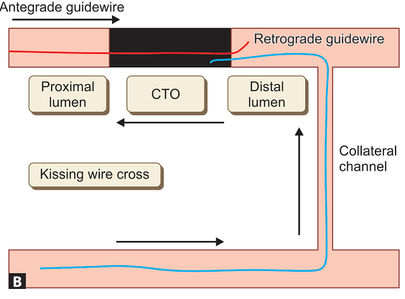
Kissing wire cross

Slide 104
Controlled antegrade and retrograde tracking
Simultaneous antegrade + Retrograde
Antegrade advancement of guidewire into subinitmal space at CTO
Retrogradely the collateral is crossed, OTW balloon or microcath is placed in distal lumen
Distal CTO subintimal space penetration
Retrograde ballon advancement and inflation
Antegrade wire maneuvered into this space and then into true lumen
Lesion is dilated & stented

Slide 105
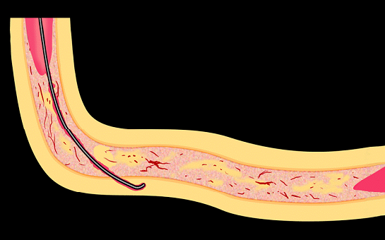
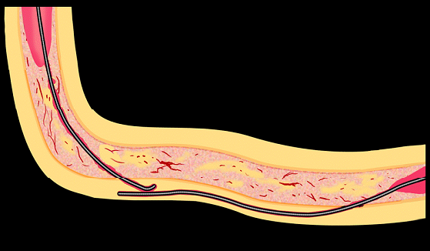
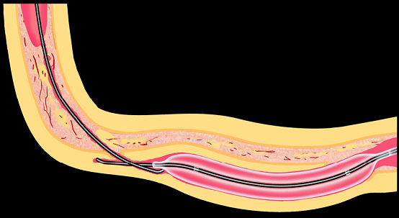
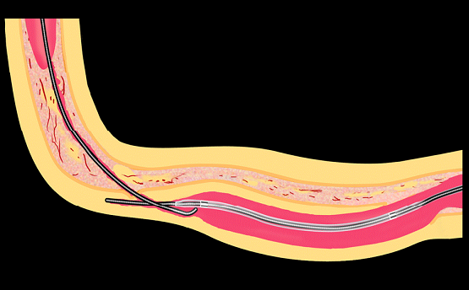
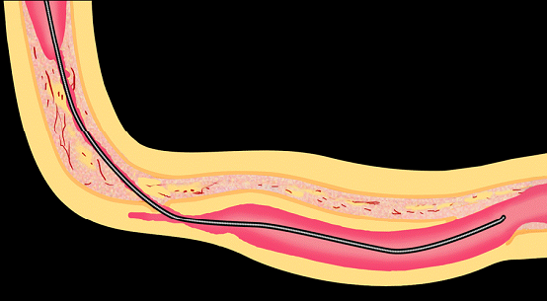
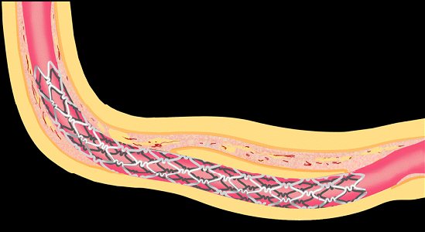
Controlled antegrade and retrograde tracking
CART

Slide 106
CART
Main reason for procedural failure- Inability to negotiate OTW balloons across the long and tortuous collateral channel
Serial dilations of collateral channel
Corsair dilation catheter
If fails- Reverse CART technique

Slide 107
Corsair micro catheter
2.7-F Catheter with OTW hybrid catheter
Both microcatheter and support
Bidirectional wire braiding for torque transmission
Inner lumen polymer lumen with soft tip for optimal wire control
Super selective injection for collaterals

Slide 108
Reverse CART

Slide 109
Reverse CART
Similar to the CART procedure
Balloon dilation is done over antegrade wire to increase subintimal space at proximal CTO site
Retrograde wire is then negotiated subintimally to seek the proximally created subintimal space
Externalisation of wire & then passage of balloon & stent

Slide 110
Confluent balloon technique
Simultaneous balloon dilation over both antegrade and retrograde wires
Common subintimal space is created

Slide 111
IVUS guided reverse CART
Increase success of reverse CART
IVUS catheter is advanced antegradely, after antegrade wire balloon dilatation
IVUS catheter is used to assess subintimal space, visualize the connecting channel and aid the guided crossing of retrograde wire into the proximal true lumen

Slide 112
Subsequent steps
Enter antegrade guide catheter with retrograde wire
Trap wire inside antegrade guide catheter with balloon
Track retrograde microcatheter into antegrade guide
Exchange to a double length (330cm floppy wire RG3, etc)
Wire externalization (use of snare, if required)
Antegrade serial balloon dilatation and stenting

Slide 113
Removal of hardware
Very important steps to prevent injury to vessels
Retrograde wire should always be within microcatheter
Avoid deep-throating of guide when retrograde wire removed
Avoid tension in the collateral wire
Check for collateral vessel damage by angio
Check donor artery for any complications post-procedure

Slide 114
Retrograde CTO PCI: Success and complications meta-analysis
El Sabbagh A et al; Angiographic success and procedural complications in patients undergoing retrograde percutaneous coronary chronic total occlusion interventions: a weighted meta-analysis of 3,482 patients from 26 studies.Int.J.Cardiol:2014,174:243,8

Slide 115
CTO PCI periprocedural MI
Dallas VAMC
2012-2015
n=30
n=39
P=0.008
n=65
n=50
33%
33%
11%
10%

Slide 116
CTO PCI: Success and complications
Karmpaliotis, Michael, Brilakis, Lombardi, Kandzari et al. JACC Intv 2012;5:1273-9
Michael, Karmpaliotis, Brilakis, Lombardi, Kandzari et al. Am J Cardiol 2013;112:488-492

Slide 118
Conclusion
CTOs are common
PCI for CTO- last frontier of coronary interventions
CTO revascularization can provide significant clinical benefits
CTO PCI can be achieved with high success and low complication rates and can be cost-effective
Learning curve exists and proper training/experience necessary

Slide 119
Thank You..
As these advances are disseminated, the new era of CTO revascularization in patients with symptoms and/or ischemic burden begins in which
the question is not “Why should we open the occluded vessel?”
But
“What is the justification to leave the vessel closed?”

